Slide 1
Internet Of Things

Slide 2
What is IOT?
The Internet of Things (IOT) is the network of physical objects—devices, vehicles, buildings and other items embedded with electronics, software, sensors, and network connectivity—that enables these objects to collect and exchange data.
IOT allows objects to be sensed and controlled remotely across existing network infrastructure, creating opportunities for more direct integration between the physical world and computer-based systems, and resulting in improved efficiency, accuracy and economic benefit.

Slide 3

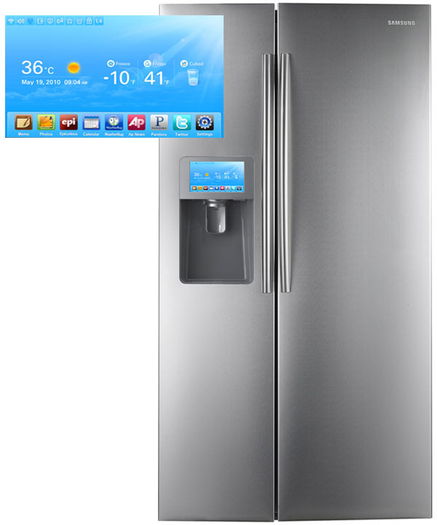
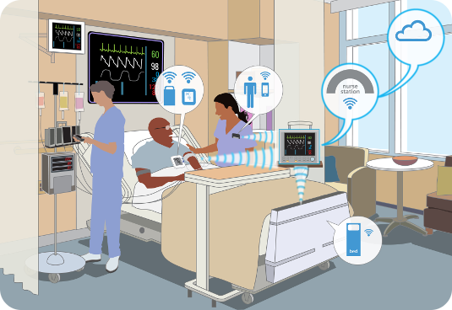
Where is IOT?
Smart Appliances
Healthcare
Wearable Tech

Slide 4
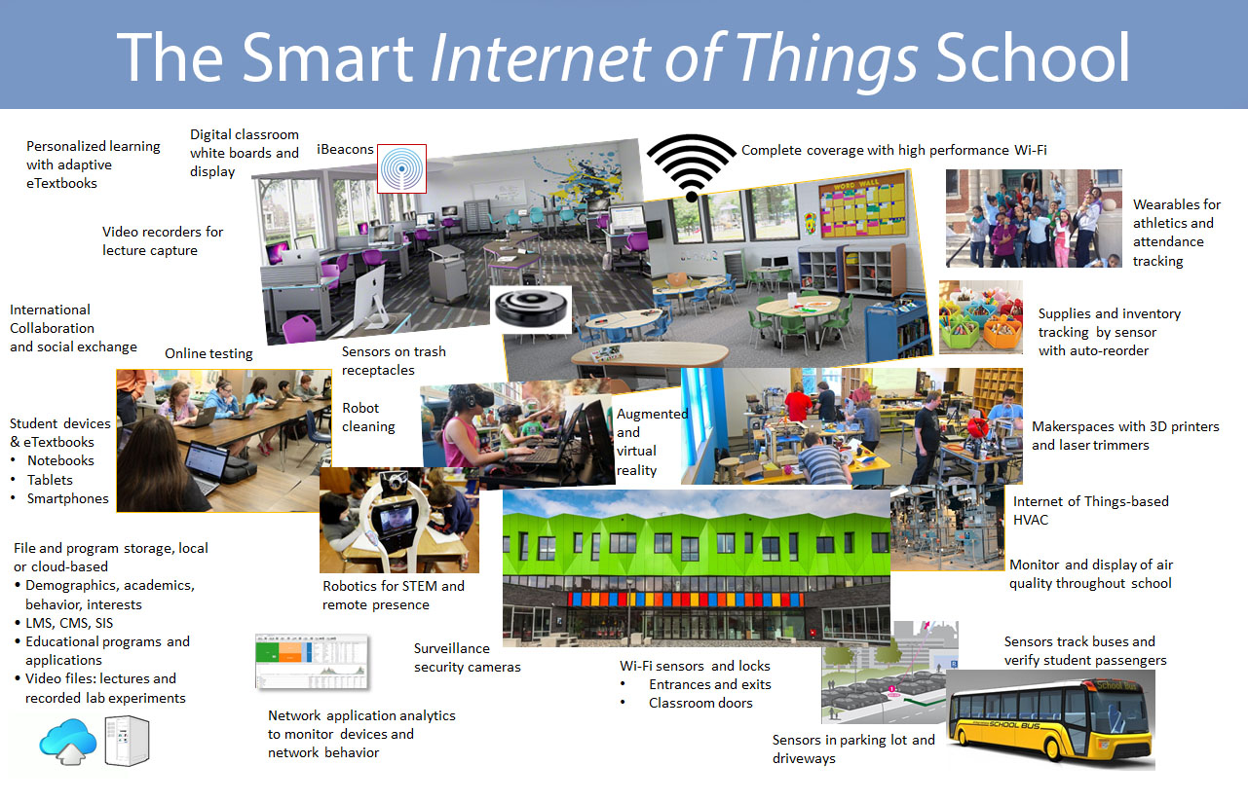

Slide 5
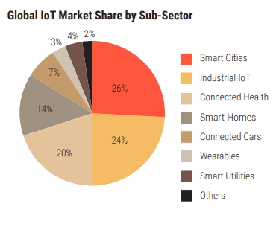
Current Status & Future Prospect of IOT

Slide 6
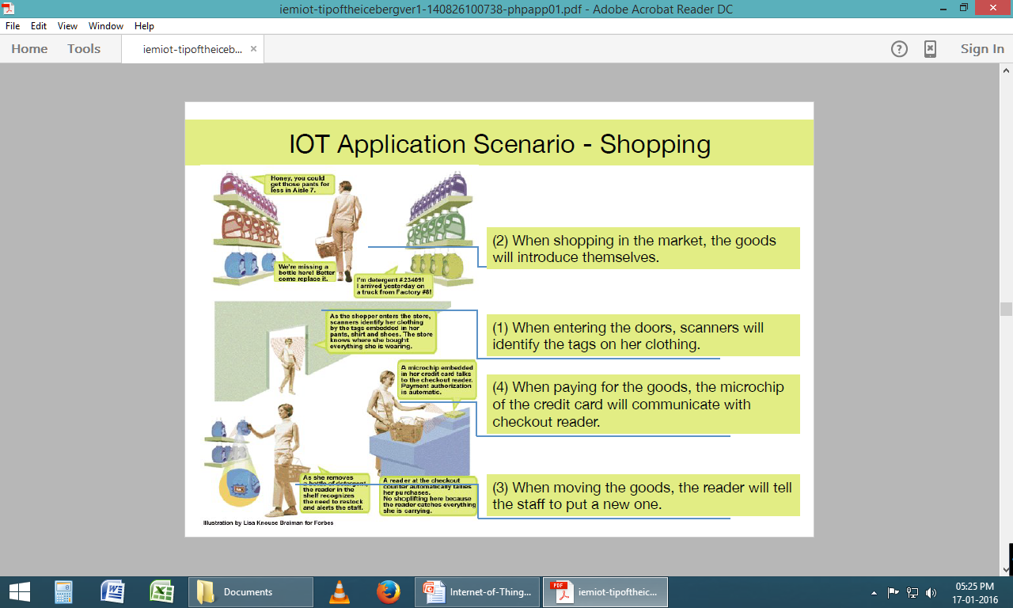

Slide 7
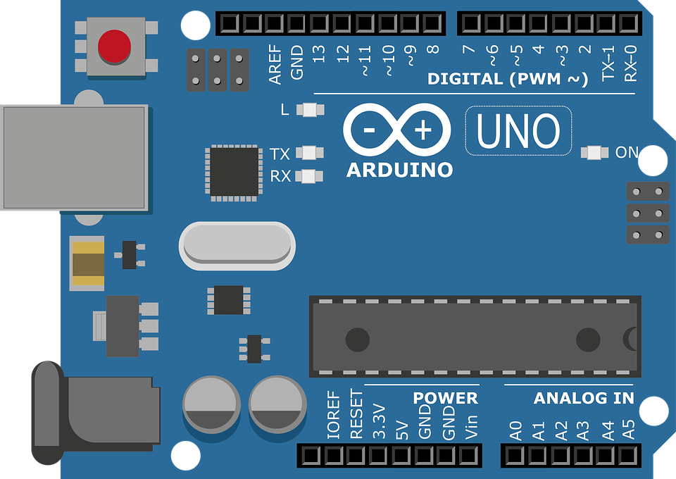
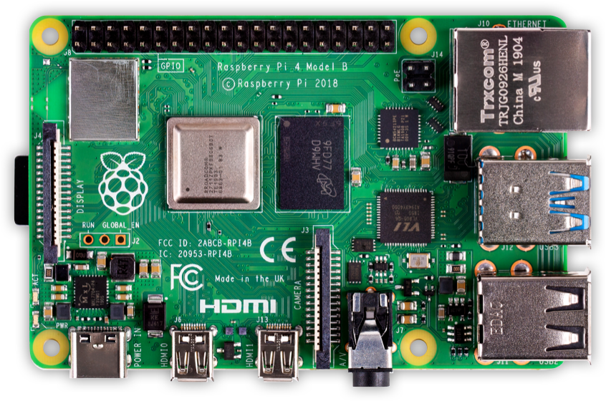
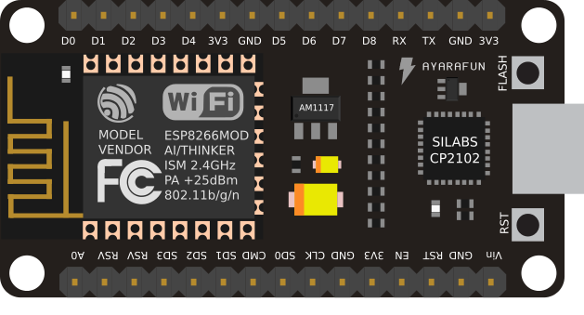
Different Hardware for IoT
ARDUINO
NODE MCU
RASPBERRY PI

Slide 8
Comparison
 | ESP8266 (Node MCU) | Arduino | Raspberry Pi
Cost | ~ INR 300 | ~ INR 400 | ~INR 2500
Wifi | Built-in | ESP8266 Module ~ INR 150 | USB Dongle / INBUILT / Ethernet
Programming | C++/Lua | C++ | Python/Java/C++
Storage | Built-In | Built-In | SD-Card
I/O | 10 GPIO/ 1 ADC | Arduino Uno: 13 GPIO/ 6 ADC | 17 GPIO

Slide 9
Comparison
 | ESP8266 (Node MCU) | Arduino | Raspberry Pi
Operating Voltage | 3.3v | 5v | 5v
Clock Speed | 26 MHz – 52 MHz | 16 MHz | 1.2GHz
Flash Memory | Upto 128 MB | 32 KB | -

Slide 10
Software Installation
Arduino IDE Setup
Package Installation for Node MCU
Selection Board from Board Manager
Assigning the Port to the Board

Slide 11
First Program
Writing the first Arduino Program
to Glow and Blink a LED
Components Used –
Node MCU Development Board
USB Cable
LED
Breadboard
Jumper Wires

